Slide 1
Chapter 1 An Overview
NET3207 Network Management

Slide 2
Network Management: Overview

Slide 3
NET3207 Network Management
An Overview
What is Network Management?
Network management refers to the activities asscoiated with running a network, along with the technology required to support those activities.
Health care – the network.
Throwing a party – like running a big party, many activities are involved with running a network.

Slide 4
NET3207 Network Management
An Overview
A more formal definition..
Network management refers to the activities, methods, procedures, and tools that pertain to the operation, administration, maintenance, and provisioning of newtorked systems.
Notes:
Explain each term. Operation, administration, maintenance, provisioning.

Slide 5
NET3207 Network Management
An Overview
A more formal definition..
Network management refers to the activities, methods, procedures, and tools that pertain to the operation, administration, maintenance, and provisioning of newtorked systems.
Notes:
Explain each term. Operation, administration, maintenance, provisioning.

Slide 6
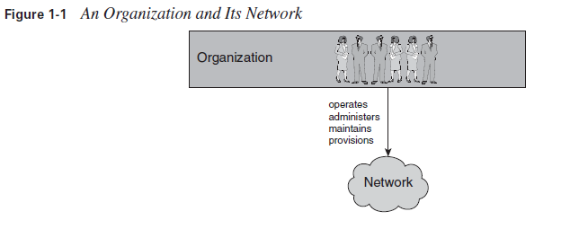
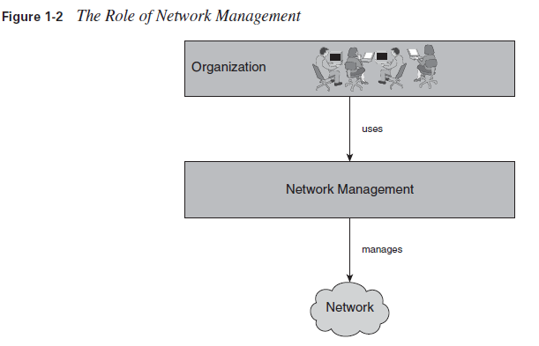
NET3207 Network Management
An Overview
Notes:
Explain each term. Operation, administration, maintenance, provisioning.

Slide 7
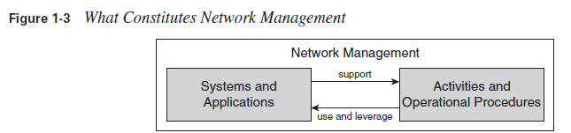
NET3207 Network Management
An Overview
What constitues Network Management
A narrow definition of network management would not refer to “Networked systems”, but simply “communication network”.
Notes:
Explain each term. Operation, administration, maintenance, provisioning.

Slide 8
NET3207 Network Management
An Overview
Important factors of Network Management
Who can operate the network at the lowest possible cost?
Who can provide better customor experience?
Who can aintain and guarantee the highest quality of service?
Who can roll out services fast and efficiently?
  Operational cost
  Equipment cost
Notes:
Explain each term. Operation, administration, maintenance, provisioning.

Slide 9
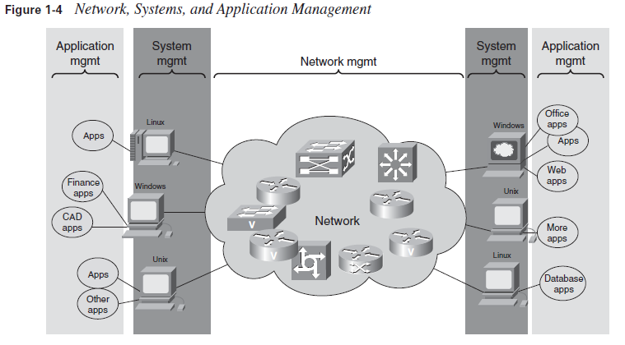
NET3207 Network Management
An Overview
Notes:
Explain each term. Operation, administration, maintenance, provisioning.

Slide 10
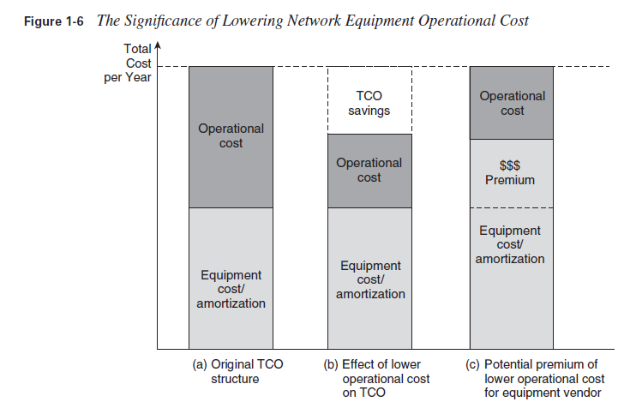
NET3207 Network Management
An Overview
Network Equipment Operational Cost
Notes:
Explain each term. Operation, administration, maintenance, provisioning.

Slide 11
NET3207 Network Management
An Overview
Quality
A good network should have good quality but not only cheap to run.
Reliability and availability are attributes that are typically associated only with the network itself.
Notes:
Explain each term. Operation, administration, maintenance, provisioning.

Slide 12
NET3207 Network Management
An Overview
Revenue
Network management is not just related to cost and quality. Network management can also be a revenue enabler that opens up market opportunities that would not exist without it. Here are some examples:
A management system that automates the complete workflow, from ordering the service to turning it up, obviously provides greater speed than workflows that involve human operators who need to key data into multiple systems redundantly along various steps of the way.
the capability to track accounting charges online and to configure service features over the Web (examples for voice: caller ID, follow-me services) and have them take effect immediately constitutes a valuable service feature.
Notes:
Explain each term. Operation, administration, maintenance, provisioning.

Slide 13
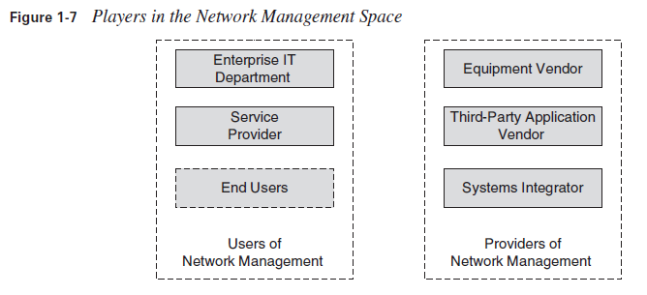
NET3207 Network Management
An Overview
Network management’s players
Many different types of service providers exist, categorized along different critiria.
Notes:
Explain each term. Operation, administration, maintenance, provisioning.

Slide 14
NET3207 Network Management
An Overview
Network management’s players
Enterprise IT Department – Generating revenue, profits, making money are not important.
The end user – Network managers, craft technicians.
Notes:
Explain each term. Operation, administration, maintenance, provisioning.

Slide 15
NET3207 Network Management
An Overview
Network management providers
Equipment Vendor – selling network equipment.
The Third-Party Application Vendor – management application.
The System Integrator – provide services to integrate a set of management applications with a specific network and operations support environment.
Notes:
Explain each term. Operation, administration, maintenance, provisioning.

Slide 16
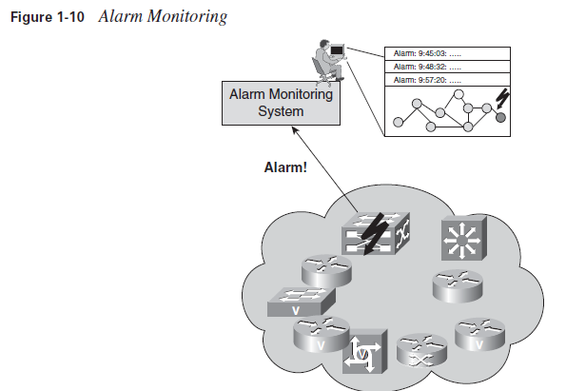
NET3207 Network Management
An Overview
Application Characteristics
Transcation-based system characteristics.
Interrupt-driven system characteristics.
Number-crunching system characteristics.
  To identify bottlenecks, assess whether service levels are being met, evaluate utilization of network resources and efficiency of the network, understand traffic patterns, and analyze trends for planning future network rollout.
Notes:
Explain each term. Operation, administration, maintenance, provisioning.

Slide 17
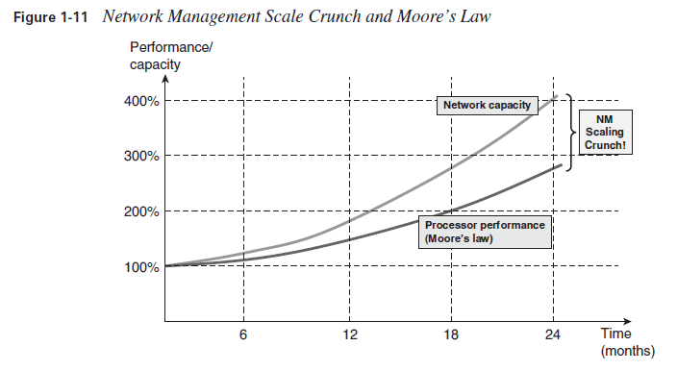
NET3207 Network Management
An Overview
Scale
It is imporant to be able to build the system so that it doesn’t break down as you have to networks of a very large scale.
Notes:
Explain each term. Operation, administration, maintenance, provisioning.

Slide 18
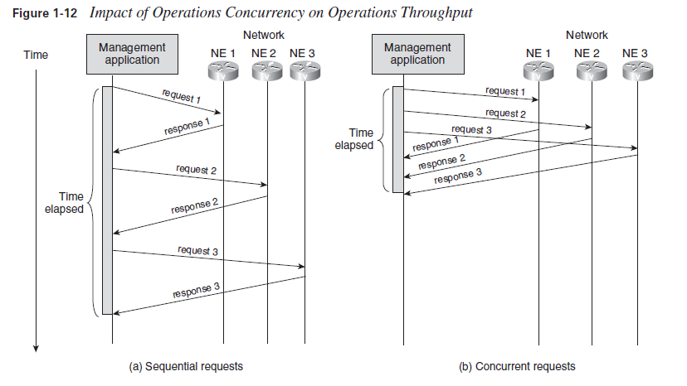
NET3207 Network Management
An Overview
Scale – cont.
Operations concurrency – maximize concurrency, minimize response time.
Event propagation – how to allow events proposage efficiently.

Slide 19
NET3207 Network Management
An Overview
Scale – cont.
Distribution and addressing - How to allow processing to be distributed across different systems to allow the introduction of additional hardware horsepower when required, and how to provide for location transparency and efficient addressing to shield application logic from such distribution.

Slide 20
NET3207 Network Management
An Overview
Cross-Section of Technologies
Information Modeling – relationships among network devices, services and users.
Databases – persistent storage.
Distributed Systems – capability to fail over between systems.
Communication Protocols – management communications overhead.
User Itnerfaces – important factor during design stage.
Other considerations – good understanding of the managed technology itself is required.

Slide 21
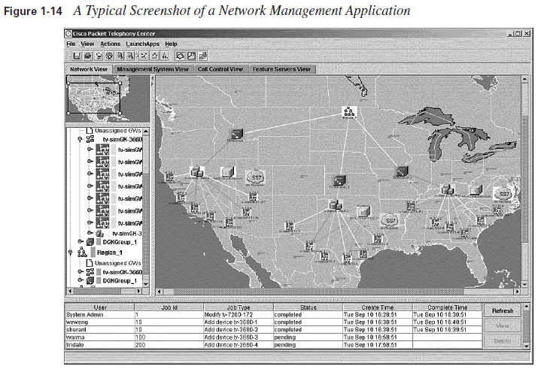
NET3207 Network Management
An Overview
User Interfaces

Slide 22
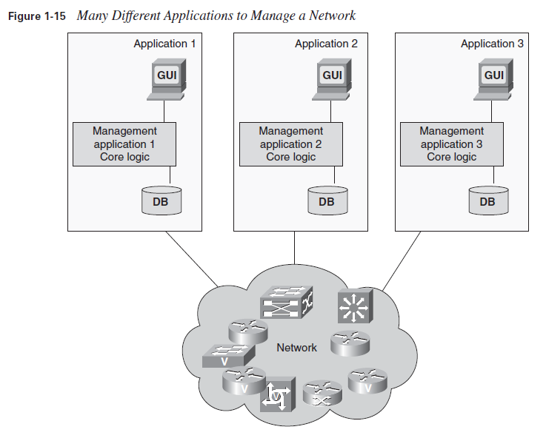
NET3207 Network Management
An Overview
Integration
Different applications can be used to monitor a network and to provision services over a network.
Integration is the key in network management !

Slide 23
NET3207 Network Management
An Overview
Organization and Operation Challenges
Functional Division of Tasks
Geographical Distribution
Operational Procedures and Contigency Planning

Slide 24
NET3207 Network Management
An Overview
Business Challenges
Placing a value on network management – Network management costs money.
Feature vs. Product - the success of the vendor comes down to how well the network equipment products do in the marketplace.

Slide 25
NET3207 Network Management
An Overview
Chapter Summary
Brief overview of network management.
Network management refers to the activities, methods, procedures, and tools that pertain to the operation, administration, maintenance, and provisioning of networked systems.
In other words, network management is about running and monitoring networks

